Slide 1
ISM 6225 Distributed Information Systems Instructor:Daniel Clinton Spring 2023
Final Project:Adventure Travel Website
Group 11:
Madhumitha Jeripothula
Madhu Kore
Sai Koti Reddy Seelam
Sri Venkatesh Kumar Sattu

Slide 2
AGENDA
The Project
Construction of the Design
Demo of the Website
Analytics
Operation of the code
Implementation of Flask
Database Functionality

Slide 3

Website Briefing
Our Adventure Travel Website Stands Out By Offering Curated, Personalized Adventures With Expert Local Guides, Emphasizing Responsible Travel Practices And Providing Comprehensive Trip Planning For A Seamless, Unforgettable Experience.

Slide 4
Construction of Design
Home
About us
Blog
Analytics
Services
Menu
Register
Footer
Login
Contact

Slide 5

Why Flask?
A Python web framework that is lightweight and flexible, allowing for easy integration with other Python libraries and tools.
The framework benefits from a vast and highly engaged community of developers.

Slide 6
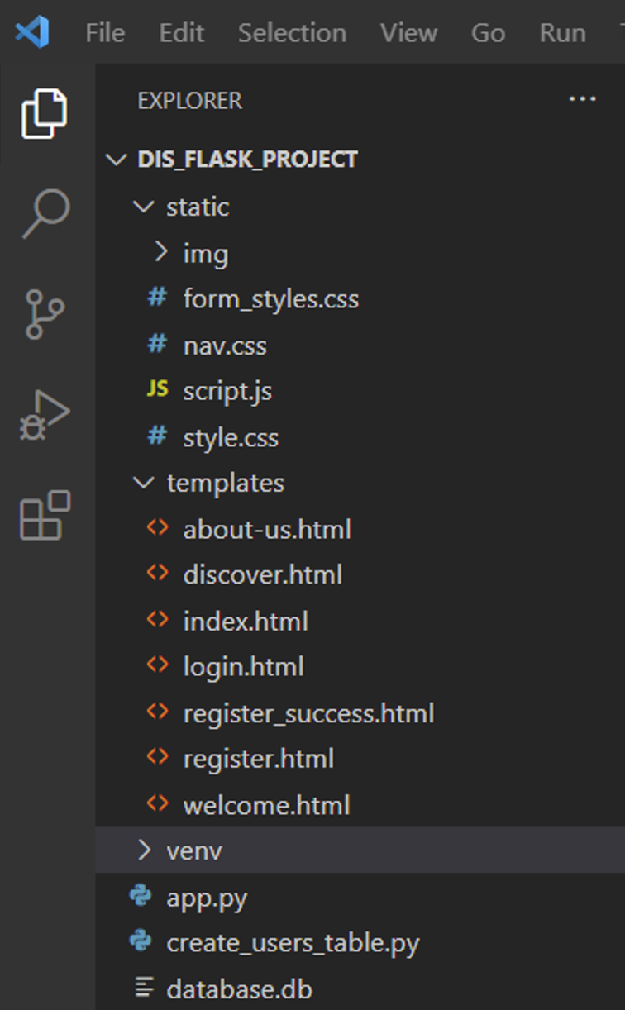
The Design:
To develop and bring our project to life, we utilized several markup
and programming languages, including:
HTML,
Custom CSS,
Bootstrap Framework
JavaScript, and
Python Flask.

Slide 7
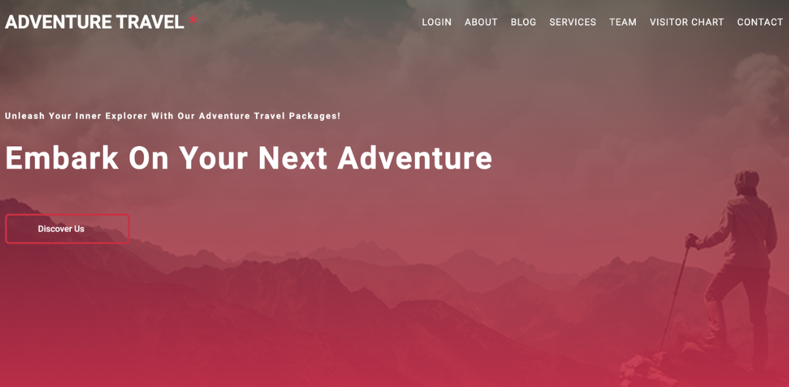
Home Page:
On our home page, users can easily navigate to all other pages of the project. This provides a convenient and efficient way for users to access all of the features and information offered on our website. Where the visitor can discover the highlights of the website.

Slide 8
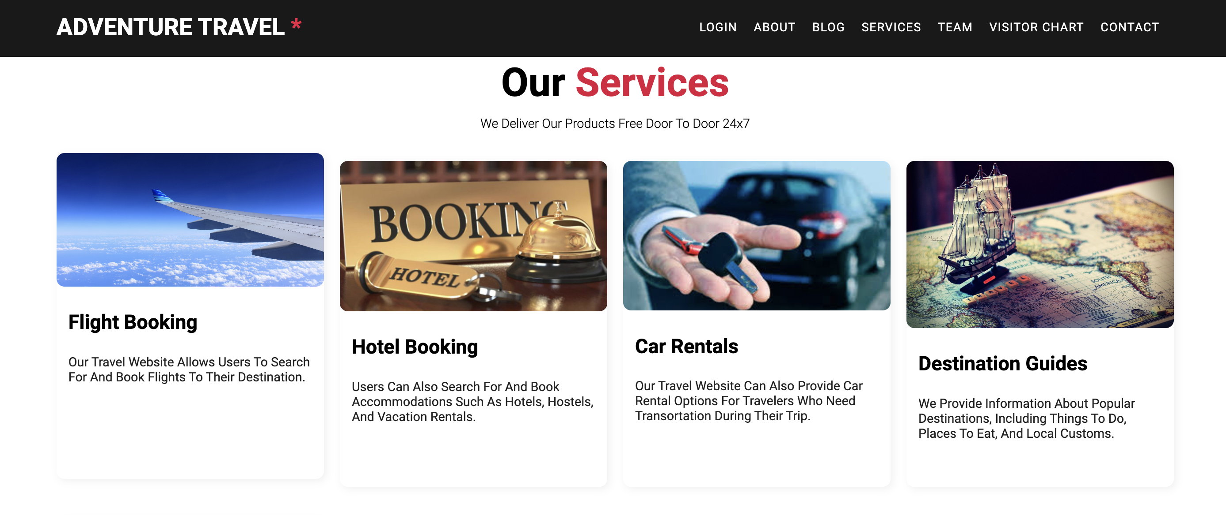
Our Services:

Slide 9
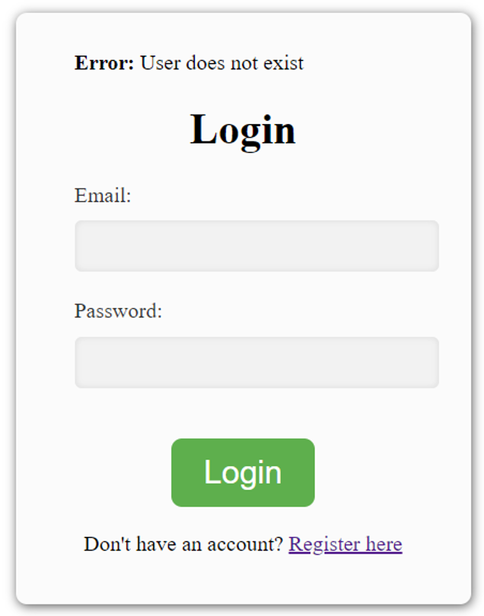
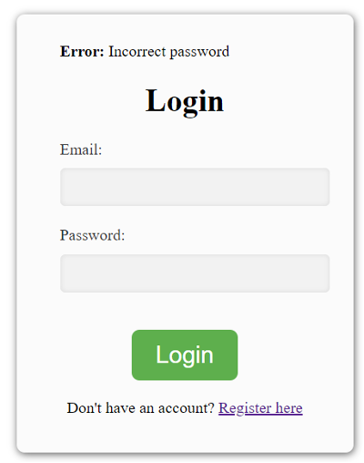
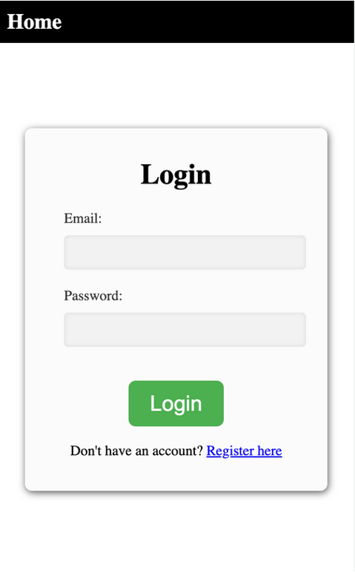
Login/Register:

Slide 10
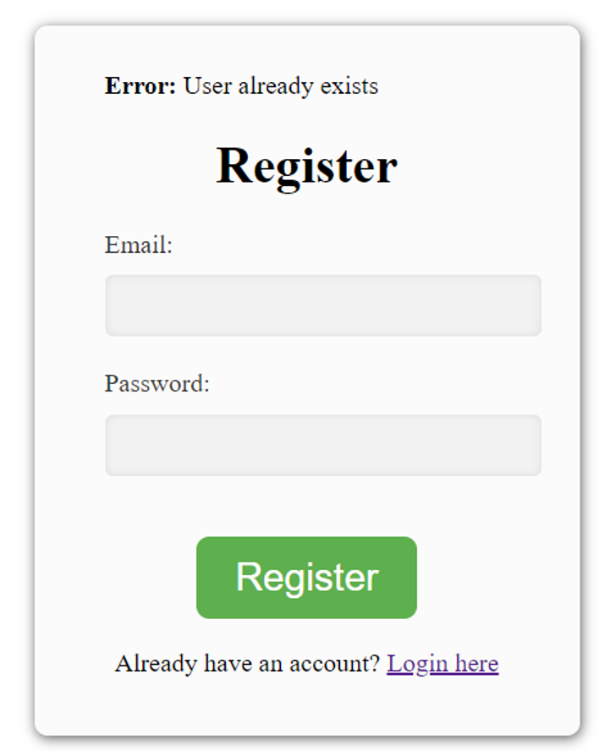
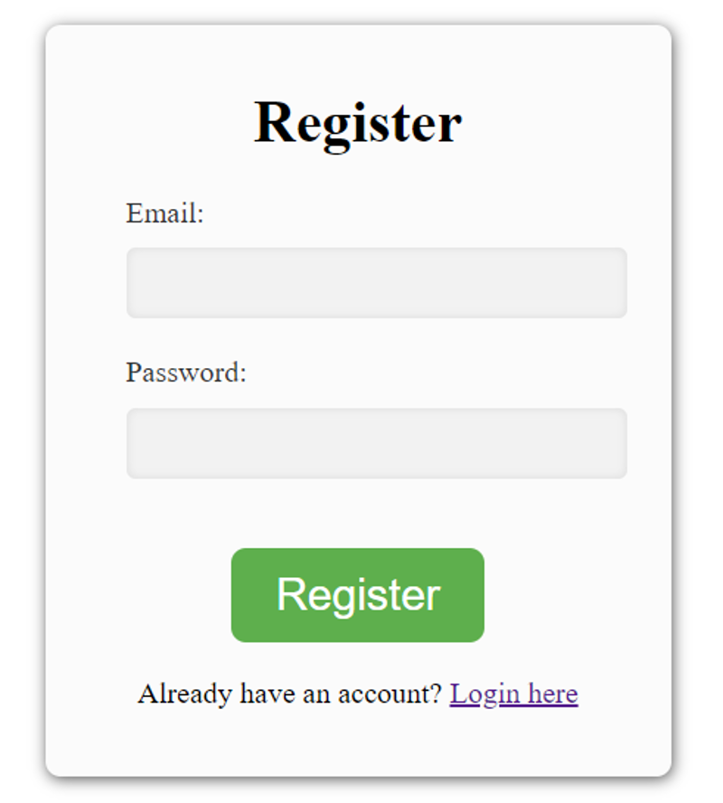
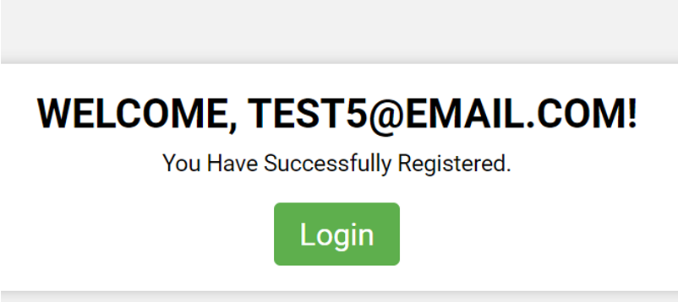
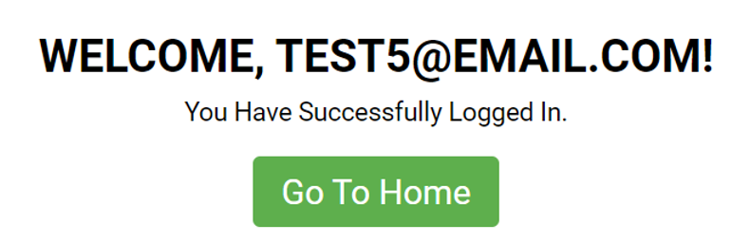
Login/Register:

Slide 11
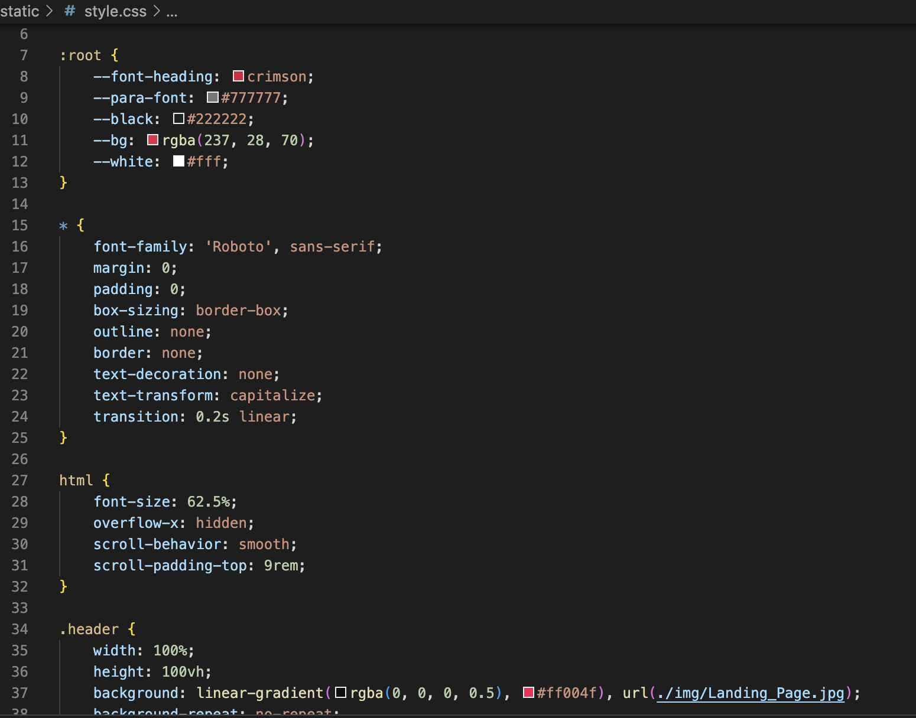
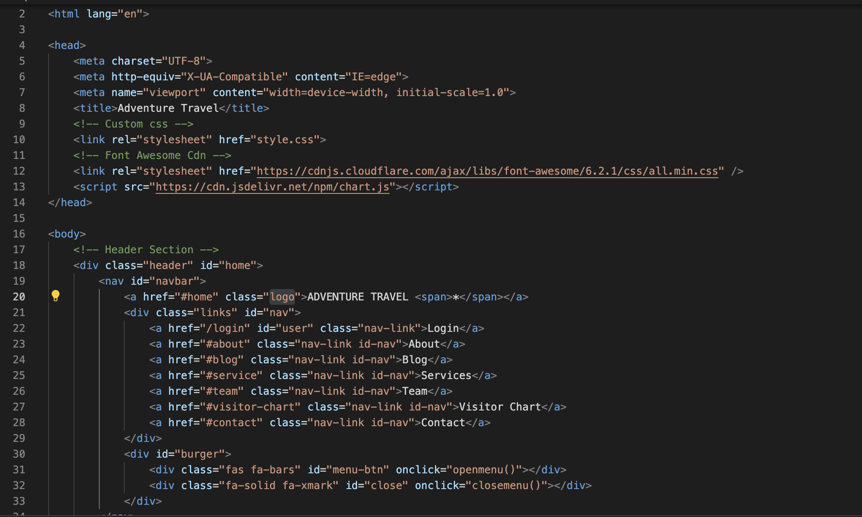
Functioning of Code(HTML, CSS)

Slide 12
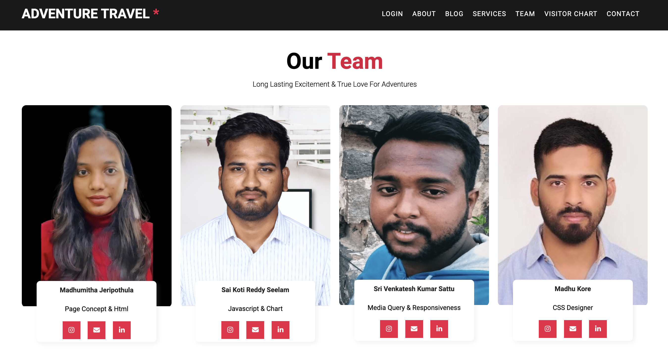
Overview of Website
Apart from the roles and responsibilities mentioned we have equally contributed our efforts for the Flask project , Slides and Presentation

Slide 13
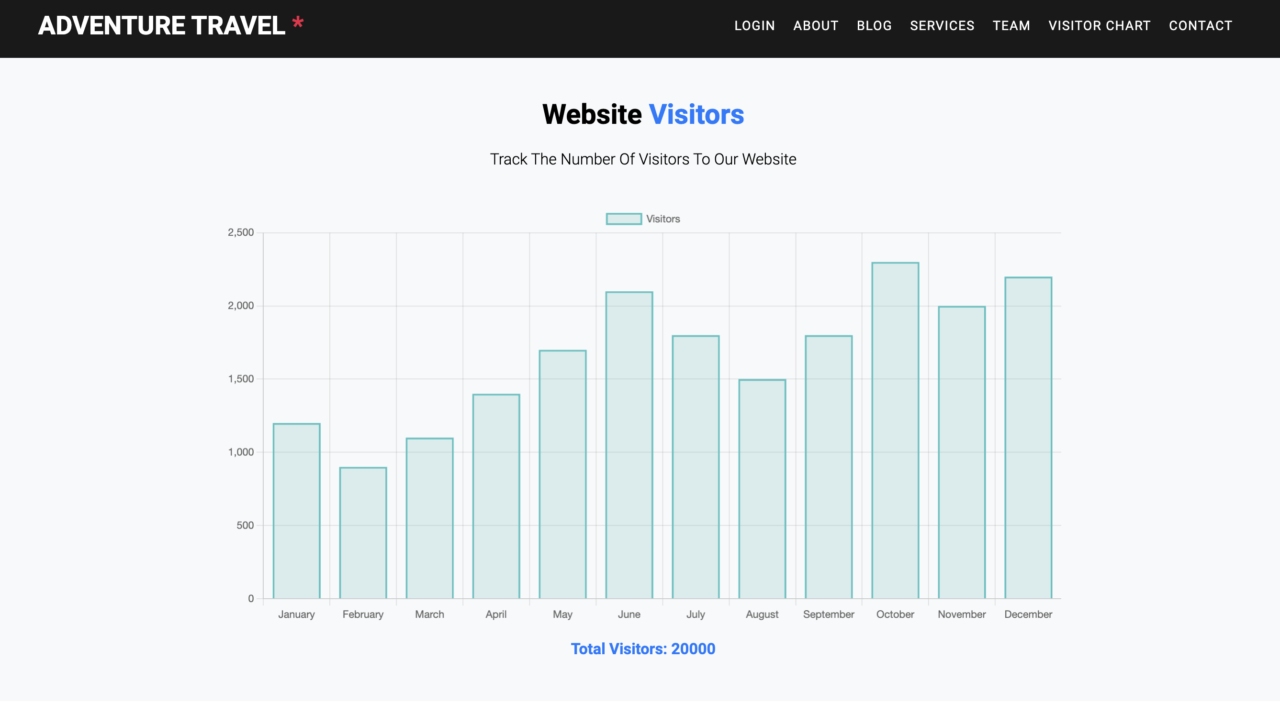
Analytics
◦A chart is shown using Chart.js for the no. of visitors to the website. Well, this is helpful on a two-way note.
One way this helps us to know the popularity building to our website and the connections could make to work on our website to make it more user-friendly to our customers and also to grow us bigger & better.
In another way, It will help the newcomers to trust our services based on the chart insights.

Slide 14
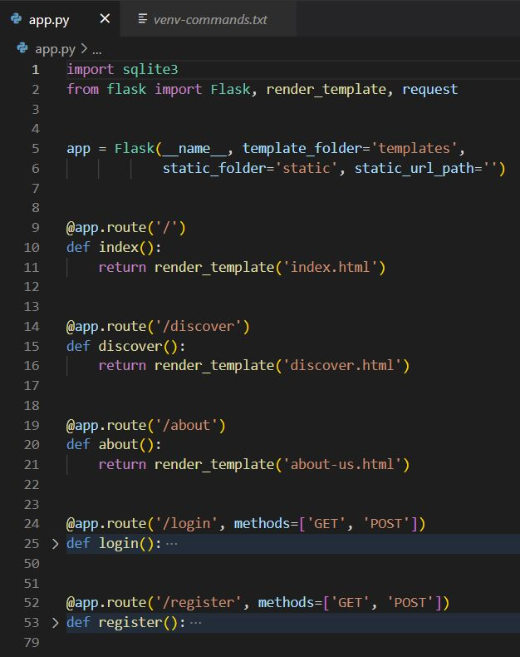
Implementation of Flask

Slide 15
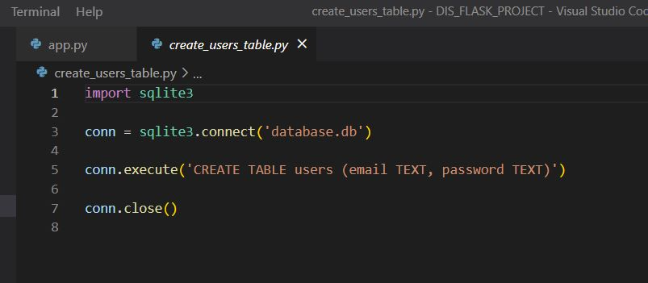
Database Functionality:

Slide 16
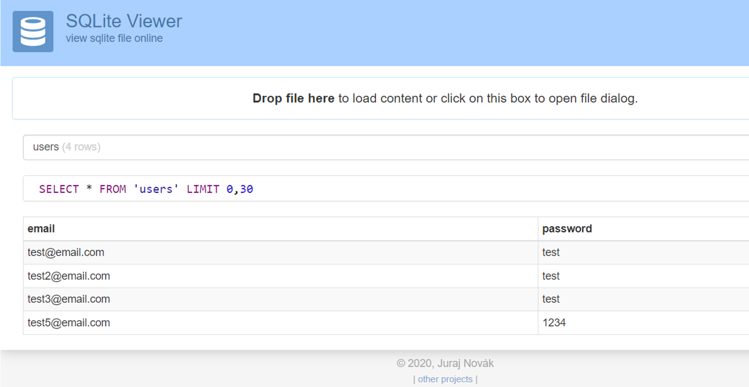
Database.db:
Here you can able to see the user details that are being stored and retrieved from a local database.
Below is the snippet from SQLite Online Viewer (drag and drop the database.db in

Slide 17
Questions?

Slide 18
Thank You!

